Slide 1
The History of RAM
By: Karman Gill

Slide 2
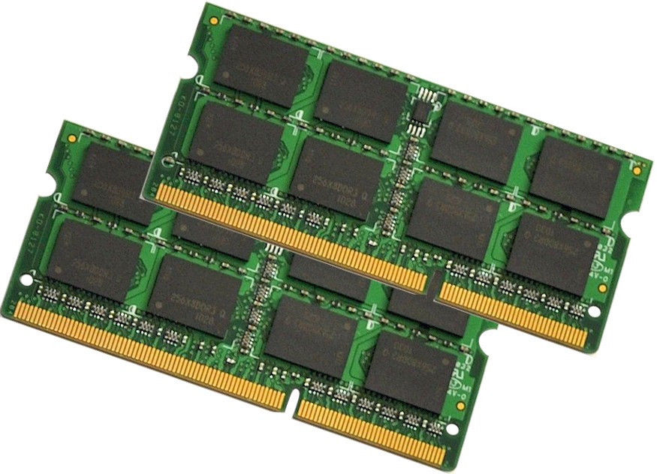
What is RAM
RAM is a type of computer data storage
RAM is able to find specific piece of information very fast
RAM devices are used in computer systems as the main memory
RAM memory is very volatile
RAM devices is integrated circuits to store information
RAM is a expensive form of storage
typical computer systems may have two to eight GB of RAM

Slide 3
RAM When it first came out
The first form of RAM came out in the 1940’s

Slide 4
Through The History

Slide 5
RAM In todays date

